Slide 1
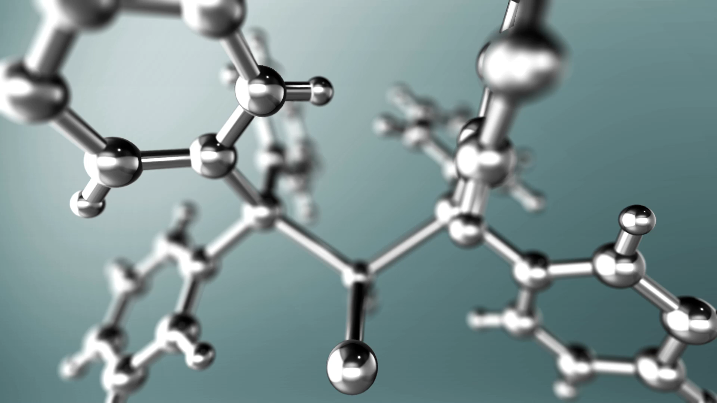
Chapter : Synthesis reactions

Slide 2
Introduction
In this context, chemical synthesis involves the production of a chemical in a cost-efficient, safe, timely manner.
Common chemicals that are synthesised include medicines, paints, plastics and beauty products.

Slide 3
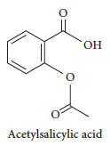
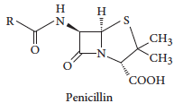
Uses of reactions
Chemical synthesis is the process of choosing suitable reactants, conditions and pathways to form a desired product.
Common medicines that have been specifically developed include aspirin (acetylsalicylic acid) and penicillin.

Slide 4
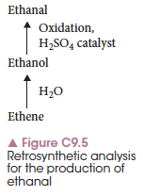
Choosing reactants
Many chemicals are produced using retrosynthetic analysis where the product is identified and chemists work backwards to choose the necessary reactants.
To synthesise organic compounds, the product structure is identified then carbons are removed, or the compound is simplified until appropriate reactants are reached.

Slide 5
Choosing a pathway
Most chemical reactions involve a number of steps. Deciding on these steps involves considering a range of factors:
Availability and cost of reactants
Conditions required, such as temperature and pressure
Other chemicals required, including catalysts
Side reactions that may occur, producing unwanted products

Slide 6
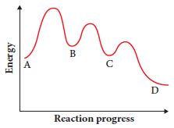
Choosing a pathway
For each step in the reaction the reactants, products and conditions must be controlled.
Products formed in one step and used in the next step are called intermediates.
An energy profile diagram for the formation of D from A is shown.
B and C are intermediates.

Slide 7
Multistep process – the Contact Process
An example of a multistep process is the production of sulfuric acid, called the contact process.
All steps have been designed so that there is as little waste, side reactions or undesired products as possible.
All steps are as energy efficient as possible and use catalysts where possible to reduce energy use.
Notes:
The details of the Contact Process can be found in the text – creation of a flowchart could be used to illustrate the reactions and conditions at each step of the process.

Slide 8
Multistep process – production of ethyl ethanoate
Ethene reacts with steam to form ethanol, then ethanol (an intermediate) reacts with acetic acid (ethanoic acid) to form ethyl ethanoate.
Conditions and chemicals in this process have been carefully chosen to maximise the amount of product formed.

Slide 9


Linear pathways
When a product is formed by starting with product A, using that to form B, then using B to form C and so on, this is a linear pathway.
The contact process is an example of a linear process.

Slide 10
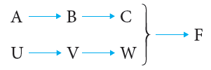
Convergent pathways
An alternate to a linear pathway is a convergent pathway.
Two chemicals are made in independent reactions then combined to make the desired product.

Slide 11
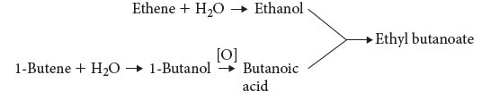
Convergent pathways
Ester formation uses a convergent pathway.
Ethanol and butanoic acid are produced separately then combined to form the ester ethyl butanoate.

Slide 12
Chapter 9: Synthesis reactions
Yields of reactions

Slide 13
What is yield?
Yield is the actual amount of products that are formed in a reaction.
This is often less than the theoretical maximum as many reactions involve an equilibrium reaction, or conditions mean that the maximum amount cannot be produced.
A high yield is desirable, but may be costly. Often a compromise has to be reached between yield and cost.

Slide 14
Maximising yield
There are a variety of ways to maximise yield by controlling the chemical reactions that occur.
Controlling the equilibrium and forcing the reaction to shift to the right can be done by:
Removal of the product as it forms
Choosing an appropriate temperature and pressure for the equilibrium reaction

Slide 15
Maximising yield
Aside from the equilibrium:
Use catalysts where possible to speed up the reaction. This produces the desired product in a quicker time but does not necessarily increase yield. It does mean more product produced per time period.
Recycle any reactants that have not been fully used so they are not wasted.

Slide 16
The Haber process
The Haber process involves the production of ammonia using the following reaction:
This reaction involves an industrial compromise.
The ideal temperature is low (explained on next slide) but this lowers the rate of reaction.
The reaction occurs at a temperature that is a compromise between the two.
Notes:
You could also teach this using the contact process: details are given in the textbook, Chapter 9 under Maximising yield.

Slide 17
The Haber process – temperature
As the reaction is exothermic, indicated by the negative enthalpy value, the forward reaction is favoured by lower temperatures.
Le Chatelier’s principle suggests low temperatures will favour the exothermic (forward) direction, maximising the yield.
As discussed, the resulting slow reaction rate means a compromise is necessary. This reaction occurs at 400–450 ̊C.

Slide 18
The Haber process – pressure
Use of Le Chatelier’s principle also gives the ideal pressure conditions.
As there are less molecules on the right-hand side of the equation, a high pressure will drive the reaction to the right.
As high pressure is expensive and dangerous to maintain, extremely high pressure is not used. A pressure of about 200 atmospheres is used.

Slide 19
The Haber process – catalyst
Catalysts do not directly contribute to yield of a reaction, but act to increase the rate of reaction.
Because the temperature of the reaction is slightly lowered to promote the equilbrium, a catalyst can help to regain some of the resulting lowered rate of reaction.

Slide 20
Contact process: sulfuric acid synthesis
Uses of sulfuric acid
The major use of sulfuric acid is in the production of fertilizers.
It is widely used in the manufacture of chemicals, e.g., in making hydrochloric acid, nitric acid, sulfate salts, synthetic detergents, dyes and pigments, explosives, and drugs.
It is used in petroleum refining to wash impurities out of gasoline and other refinery products.
Sulfuric acid is used in processing metals, e.g., in pickling (cleaning) iron and steel before plating them with tin or zinc.
Rayon is made with sulfuric acid. It serves as the electrolyte in the lead-acid storage battery

Slide 21
Synthesis of Sulfuric acid
The Contact Process is a process involving the catalytic oxidation of sulfur dioxide, SO₂, to sulfur trioxide, SO₃.
Solid sulfur, S(s), is burned in air to form sulfur dioxide gas, SO₂
S(s) + O₂(g) → SO₂(g)
or by heating sulphide ores like pyrite in an excess of air:
The mixture of sulfur dioxide and air is heated to 450ºC and subjected to a pressure of 101.3 - 202.6 kPa (1 -2 atmospheres) in the presence of a vanadium catalyst (vanadium (V) oxide) to produce sulfur trioxide, SO₃(g), with a yield of 98%.
2SO₂(g) + O₂(g) → 2SO₃(g)
Any unreacted gases from the above reaction are recylced back into the above reaction

Slide 22
Sulfur trioxide, SO₃(g) is dissolved in 98% (18M) sulfuric acid, H₂SO₄, to produce disulfuric acid or pyrosulfuric acid, also known as fuming sulfuric acid or oleum, H₂S₂O₇.
SO₃(g) + H₂SO₄ → H₂S₂O₇
This is done because when water is added directly to sulfur trioxide to produce sulfuric acid
SO₃(g) + H₂O(l) → H₂SO₄(l)
the reaction is slow and tends to form a mist in which the particles refuse to coalesce.
Water is added to the disulfuric acid, H₂S₂O₇, to produce sulfuric acid, H₂SO₄
H₂S₂O₇(l) + H₂O(l) → 2H₂SO₄(l)

Slide 23
Explaining the conditions
The proportions of sulphur dioxide and oxygen
2SO₂(g) + O₂(g) → 2SO₃(g)
Stoichiometric ration is 2:1, maintain the ratio as 1:1 provides excess of O₂
Hence shift of equilibrium towards the right, more yield of SO₃
Free Oxygen from air.

Slide 24
The temperature
You need to shift the position of the equilibrium as far as possible to the right in order to produce the maximum possible amount of sulphur trioxide in the equilibrium mixture.
The forward reaction (the production of sulphur trioxide) is exothermic.
Compromise the temperature, to get the maximum yield.
According to Le Chatelier's Principle, this will be favoured if you lower the temperature. The system will respond by moving the position of equilibrium to counteract this - in other words by producing more heat.
In order to get as much sulphur trioxide as possible in the equilibrium mixture, you need as low a temperature as possible. However, 400 - 450°C isn't a low temperature!

Slide 25
The pressure
Notice that there are 3 molecules on the left-hand side of the equation, but only 2 on the right.
According to Le Chatelier's Principle, if you increase the pressure the system will respond by favouring the reaction which produces fewer molecules. That will cause the pressure to fall again.
In order to get as much sulphur trioxide as possible in the equilibrium mixture, you need as high a pressure as possible. High pressures also increase the rate of the reaction. However, the reaction is done at pressures close to atmospheric pressure!
Economic considerations
Even at these relatively low pressures, there is a 99.5% conversion of sulphur dioxide into sulphur trioxide. The very small improvement that you could achieve by increasing the pressure isn't worth the expense of producing those high pressures.

Slide 26
The catalyst
Vanadium oxide V₂O₅
Equilibrium considerations
The catalyst has no effect whatsoever on the position of the equilibrium. Adding a catalyst doesn't produce any greater percentage of sulphur trioxide in the equilibrium mixture. Its only function is to speed up the reaction.

Slide 27
Enzymes
Enzymes are biological proteins that catalyse specific reactions in living organisms.
Their shape defines their property and each one is specific for a particular reaction, such as fat hydrolysis.
Enzymes are also used in industry to catalyse industrial reactions and increase reaction rates.
While not contributing directly to yield, they increase the amount of product produced in a period of time.

Slide 28
Calculating theoretical yield
Theoretical yield is calculated on the assumption that a reaction proceeds with 100% efficiency.
One factor that limits the theoretical yield is the limiting reactant.
One of the reactants will often run out before the other one. This is the limiting reagent and the other is said to be in excess.
Notes:
Worked example 9.1 shows how to find the limiting reagent and hence the actual yield.

Slide 29

Calculating percentage yield
Percentage yield gives a comparison of the actual yield and the theoretical yield.
Notes:
Worked Example 9.2 shows calculation of percentage yield.
Experiment 9.1 – Percentage yield of carbon dioxide
Investigation 9.1 Calculating the percentage yield

Slide 30
Chapter 9: Synthesis reactions
Soaps and detergents

Slide 31
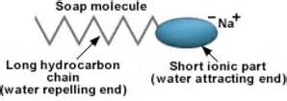


Structure
Soap consists of fatty acid salts, with a long non-polar carbon chain and a polar carboxylate ion at the other end.
The soap ion is bonded to a potassium or sodium ion, making the final structure a potassium or sodium carboxylate salt.

Slide 32
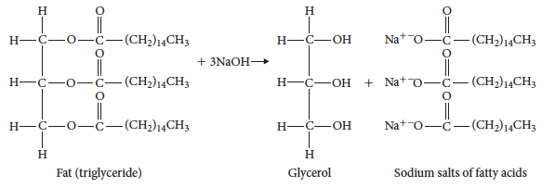
How soaps are made- alkaline hydrolysis of a plant oil or animal fat.
Fats are triesters made from a glycerol molecule attached to three fatty acid chains.
Splitting the fat molecule by adding sodium hydroxide results in the release of three fatty acid ions, which form carboxylate salts.

Slide 33
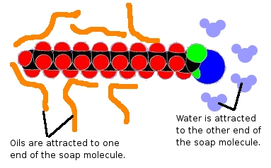
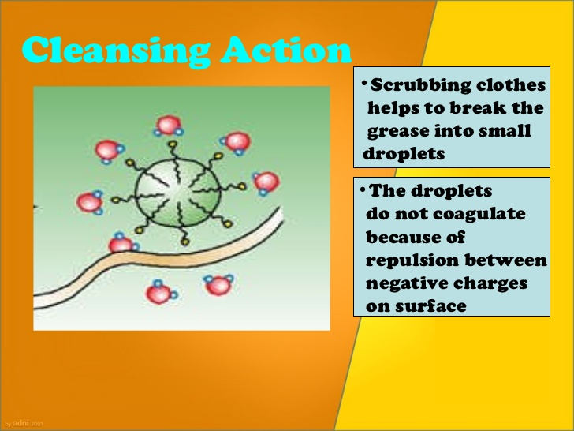
How soaps work
Soap molecules have a non-polar hydrocarbon end that can dissolve in grease, oil and other non-polar substances. It is hydrophobic.
At the other end, the molecules have a carboxylate ion, which is capable of forming bonds with polar substances, including water. It is hydrophilic.

Slide 34
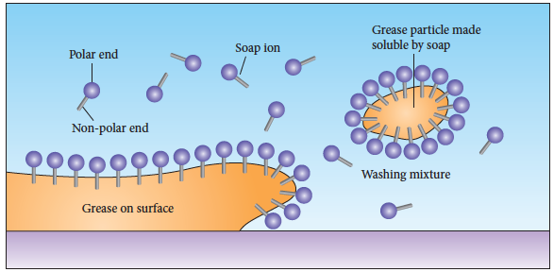
How soaps work

Slide 35
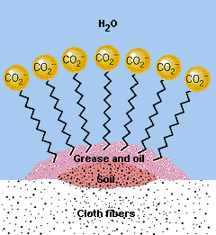
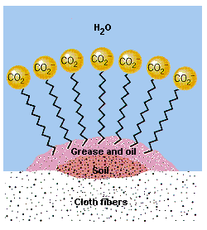
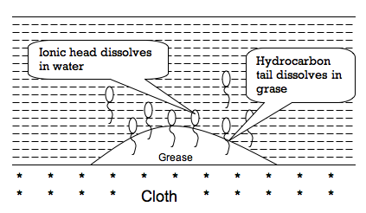
How soaps work
The hydrophobic non-polar tail bonds with grease molecules with the polar, ionic head staying outside the grease.
The soap ions surround the grease so it is surrounded by ionic ends of the soap molecules. This makes the entire structure, called a micelle, soluble in water.
When the water is washed away, the grease is washed away with the dirty water.

Slide 36
Detergents
Soaps do not work effectively in hard water. Hard water contains a high proportion of calcium and magnesium ions.
When calcium and magnesium ions bond with the soap carboxylate ions, they form an insoluble solid, making the soap ineffective as a cleaning agent.

Slide 37

Detergents
A detergent ion is similar in structure to the soap ion, however the carboxylate ion is replaced by a sulfonate ion.
Detergents do not have the same reaction with hard water so are effective cleaning agents when calcium and magnesium ions are present.

Slide 38
Chapter 9: Synthesis reactions
Fuels

Slide 39
Introduction
Fuels are organic compounds containing mostly carbon and hydrogen. When combusted they produce large amounts of energy, along with carbon dioxide and water as the primary products.
Crude oil is in short supply, and the percentages of desired fuels, such as petrol, are not high enough to meet the demand.
New fuels are being synthesised to meet this demand and hopefully go some way to replacing fossil fuels.

Slide 40
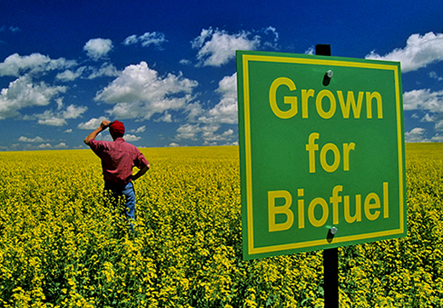
Biofuels
A biofuel is produced from crops such as corn and wheat, rather than fossil fuels.
Biofuels are renewable because the crops can be continuously produced.
In Australia, ethanol and biodiesel are the two most common biofuels.
Biofuels are liquid fuels that have been derived from other materials such as waste plant and animal matter.
The two main types of biofuels currently in production in Australia are bioethanol and biodiesel. Bioethanol is used as a replacement for petrol and biodiesel is used as a replacement for diesel.

Slide 41
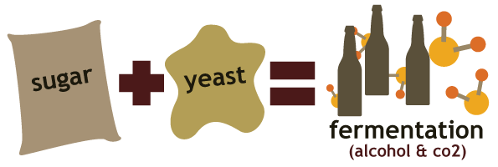
Biofuels – ethanol synthesis: fermentation
Fermentation of simple sugars produces ethanol for use as a fuel.
Simple sugars are sourced from grains or fruits. Yeast is added to the mixture to provide the enzymes that convert glucose to ethanol:
The process is anaerobic (no oxygen) and kept at a mild/warm temperature to provide optimum fermentation conditions.

Slide 42
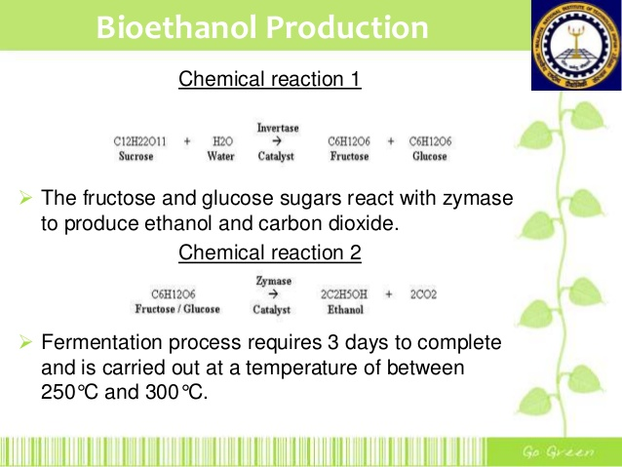
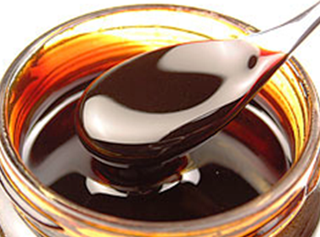
Bioethanol- specific conditions
If molasses is used-
Temp- 25-37⁰ C
pH- 3-5
Step 1. hydrolysis of sucrose.
Step2 fermentation

Slide 43

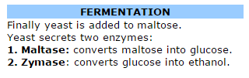

Bioethanol from starch
Starch is carbohydrate and is an important source of ethanol. Generally potato, rice, maize or barley are used as source of starch. Use of potato for starch is very common.
The crushed potato is steamed at 140OC to 150OC under pressure to prepare starch solution known as MASH.
Before hydrolysis, starch is first undergo germination at 10OC to 13OC for few days. This germinated starch is called MALT.
Starch is hydrolysed to maltose by an enzyme known as diastase.

Slide 44
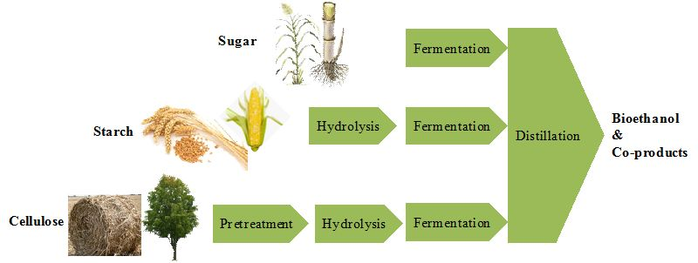
Summary

Slide 45
Obtaining pure bio ethanol
The alcohol produced by fermentation is an aqueous solution with a maximum concentration of 15%, This is increased to 95% by distillation.
The final step is to pass the distilled alcohol through a molecular sieve.
The alcohol is passed through the beds of zeolite. The zeolite sieve separates the smaller water molecules from the larger alcohol molecules and allows for the collection of relatively pure alcohol.
This ethanol is then added to petrol.

Slide 46

Biofuels – ethanol synthesis: using ethene
Industrially, steam is added to ethene (ethylene) to produce ethanol in an exothermic reaction:
As the reaction is exothermic, the reaction is favoured by low temperatures 300º C but this slows the reaction rate. Moderate temperatures are used.
High pressures and a phosphoric acid catalyst are used to increase both yield and reaction rate.

Slide 47
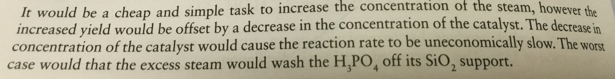
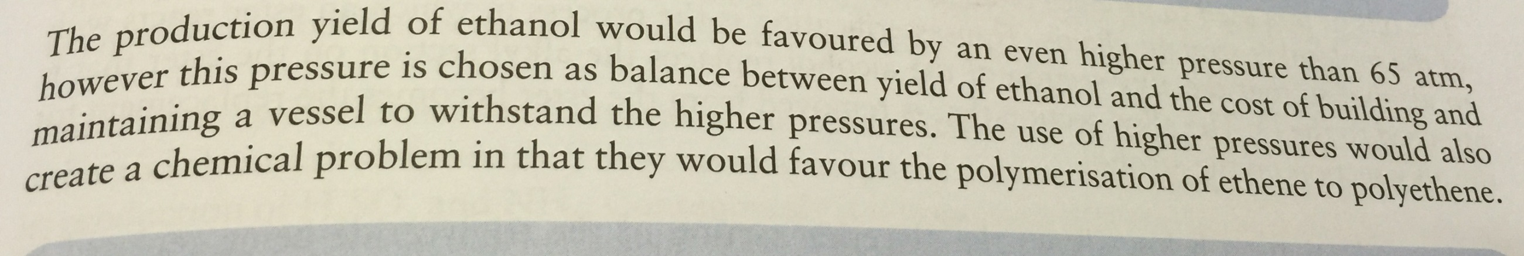
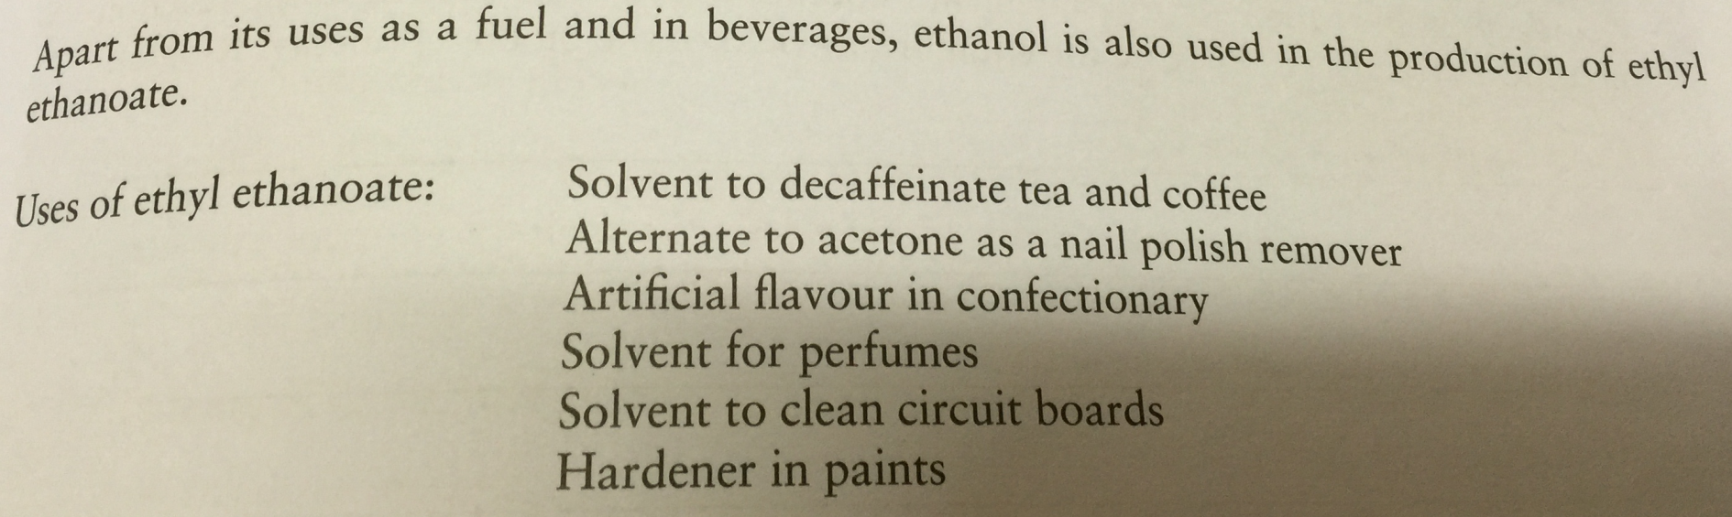
Factors affecting ethanol yield
Cheap and

Slide 48
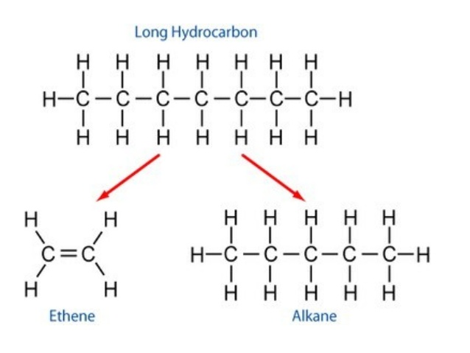
Catalytic Cracking
Cracking is the breakdown of a large alkane into smaller, more useful alkanes and alkenes.
Ethene produced in this way can be used to synthesise alcohol commercially.

Slide 49
Biodiesel
Fatty acids from plant materials such as corn and peanuts can be used to synthesise biodiesel.
Diesel is a hydrocarbon with chain length around 8–21 carbons. Biodiesel has a modified structure with an ester group due to its source being a trigylceride.

Slide 50
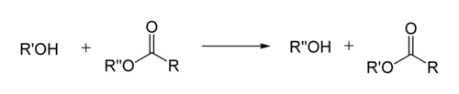
In organic chemistry, transesterification is the process of exchanging the organic group R″ of an ester with the organic group R′ of an alcohol. These reactions are often catalyzed by the addition of an acid or base catalyst.
The reaction can also be accomplished with the help of enzymes particularly lipases
.

Slide 51
Biodiesel – transesterification
A process called transesterification is used to create almost all biodiesel.
Base-catalysed transesterification uses low temperatures and pressures and has a 98% yield of product.
Reaction of a triglyceride with an alcohol forms an ester and glycerol. The ester formed is the biodiesel.

Slide 52
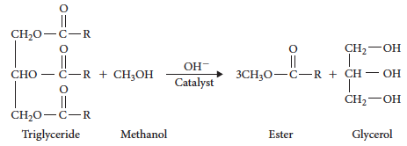
Biodiesel – transesterification
A catalyst is used in the process, often a strong alkali such as sodium hydroxide.

Slide 53
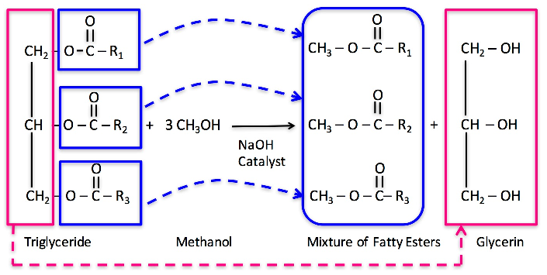
Bio diesel

Slide 54
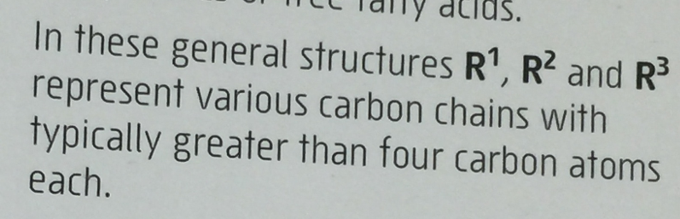
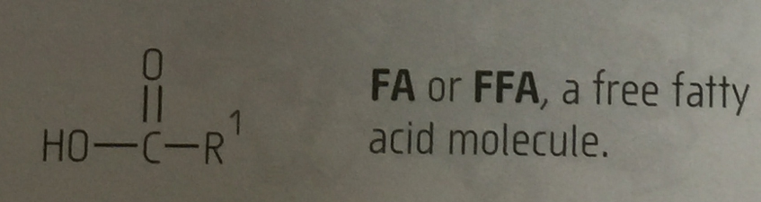
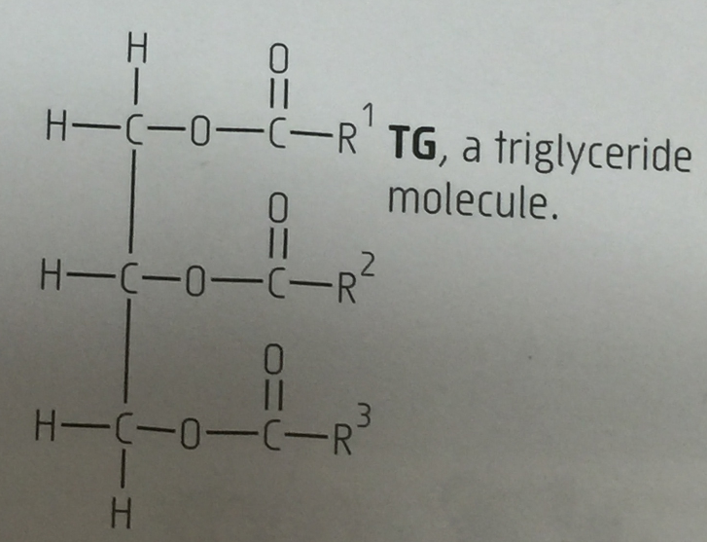
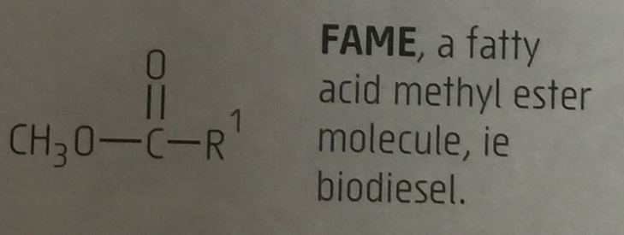
Terminology

Slide 55
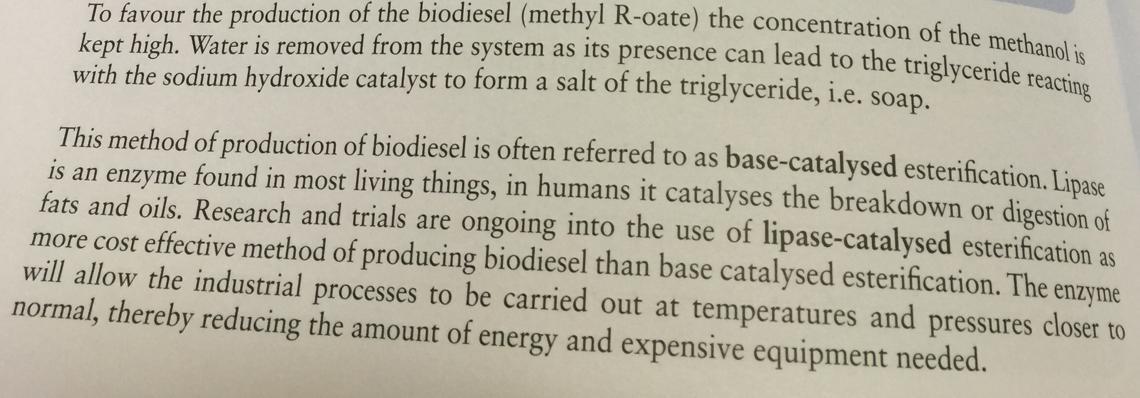
Factors affecting production yield

Slide 56
Biodiesel – transesterification
The different density liquids are separated by gravity and the ester is purified.
This process requires high temperatures and has a side product (soap) that lowers the yield.
Purification of the glycerol is also expensive.

Slide 57
Biodiesel – use of a catalyst
Lipases are biological enzymes that break down fats in the body. They can also be used to catalyse the production of biodiesel in industry.
Use of lipases reduces the production of soap, increasing the yield, but the enzymes are expensive.

Slide 58
Advantages of using Lipase
Ability to operate at milder temp and pH.
They do not cause any side reaction so no soap formation during the reaction.
They simplify product purification so no environmental problems of water disposal and water treatment.
Use less energy
Products need less purification.

Slide 59
Disadvantages of Lipase catalysed transesterification
Slower acting, so high catalytic concentration is needed.
Quite expensive impacts the competitive economics of using lipase over traditional NaOH, KOH
Recovery of lipase from reaction mixture is difficult, so fresh must be used of each batch. This increases the cost .
If lipase is used in higher cons og methanol and glycerol, they inhibit and prevents its functioning.
However this method has many potential advantages and encompasses the rules of stainability and green chemistry.

Slide 60
Chapter 9: Synthesis reactions
Green chemistry

Slide 61
Introduction
Many chemical reactions use hazardous or toxic chemicals that can have health and environmental impacts.
Green chemistry aims to reduce the use and production of these chemicals.
Industrial processes are designed and reviewed to ensure harmful products are not produced or used in the process as much as possible.

Slide 62
Pollution heirarchy
The US Federal Pollution Prevention Act of 1990 set a hierarchy that was associated with pollution:
1 Prevent pollution
2 Treat chemicals to make them safe prior to disposal
3 Dispose of untreated chemicals safely

Slide 63
Pollution hierarchy
If this hierarchy is followed when designing reactions, it is possible to create processes that meet green chemistry guidelines.
Green chemistry reduces the impact of chemistry on the environment by reducing or eliminating hazardous chemicals.
Notes:
Activity 9.1 – Builiding a better bleach. Use the activity to explore principles of Green Chemistry

Slide 64
12 principles of green chemistry
1 Prevent waste so there is no waste at the end of the process.
2 Maximise atom economy. This refers to the number of reactant atoms that are present in the final product. The more that are present, the less waste.
3 Design less hazardous chemical syntheses.

Slide 65
12 principles of green chemistry
4 Design safer chemicals and products.
5 Use safer solvents and reaction conditions.
6 Increase energy efficiency.
7 Use renewable reactants.
8 Avoid using chemical derivatives. They go through industrial processes so contribute to wastes and hazardous chemicals.

Slide 66
12 principles of green chemistry
9 Use catalysts.
10 Design chemicals that will degrade.
11 Prevent pollution.
12 Minimise the potential of chemical accidents.

Slide 67

Atom economy
Atom economy refers to the mass of reactant atoms that end up in the product.
It can be calculated by:
The more atoms that end up in the final product, the less waste there is at the end of the process.
Notes:
Worked example 9.3 shows how an atom economy calculation is performed.
Activity 9.2 – Modelling atom economy

